Slide 1
Measuring the User Experience and the Impact of Effort on Business Outcomes
Maggie Wolff
Data Scientist
American Express Global Business Travel
Notes:
I focus on product analytics and specifically how to use data to create better digital experiences

Slide 2
Agenda:
Typical ways to measure user experience
Why measure effort
How to measure effort
What can effort tell you
What to do with this information

Slide 3
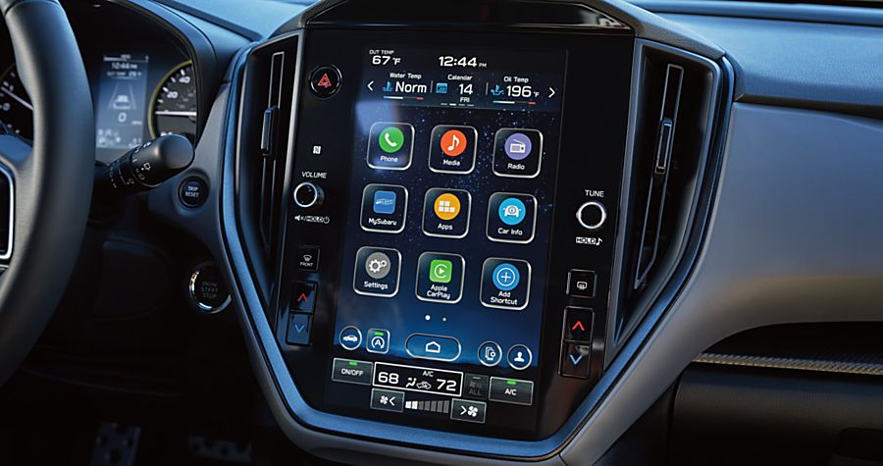
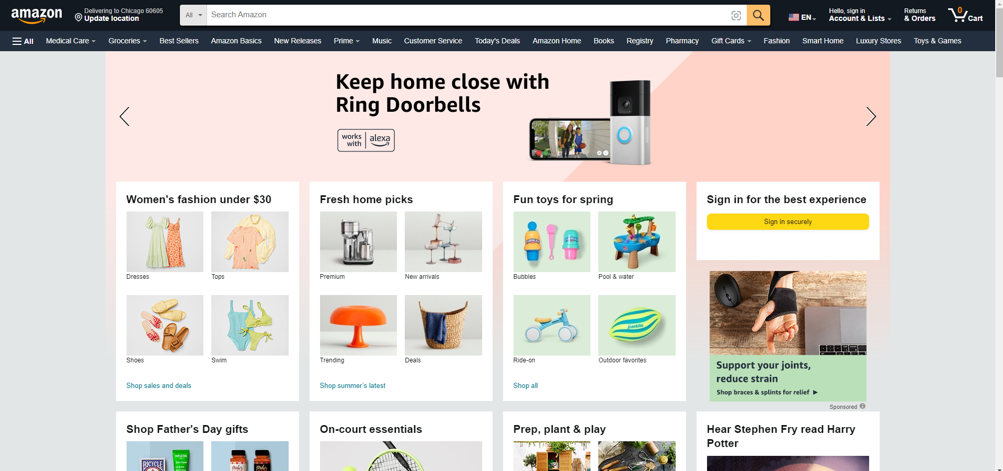
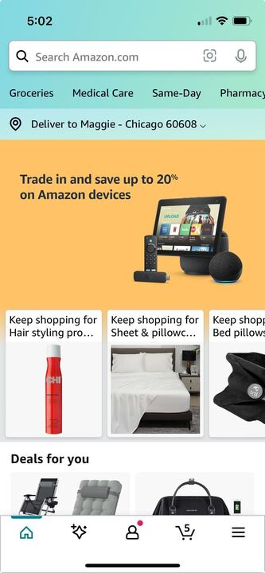
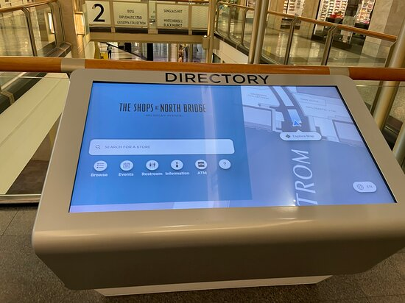
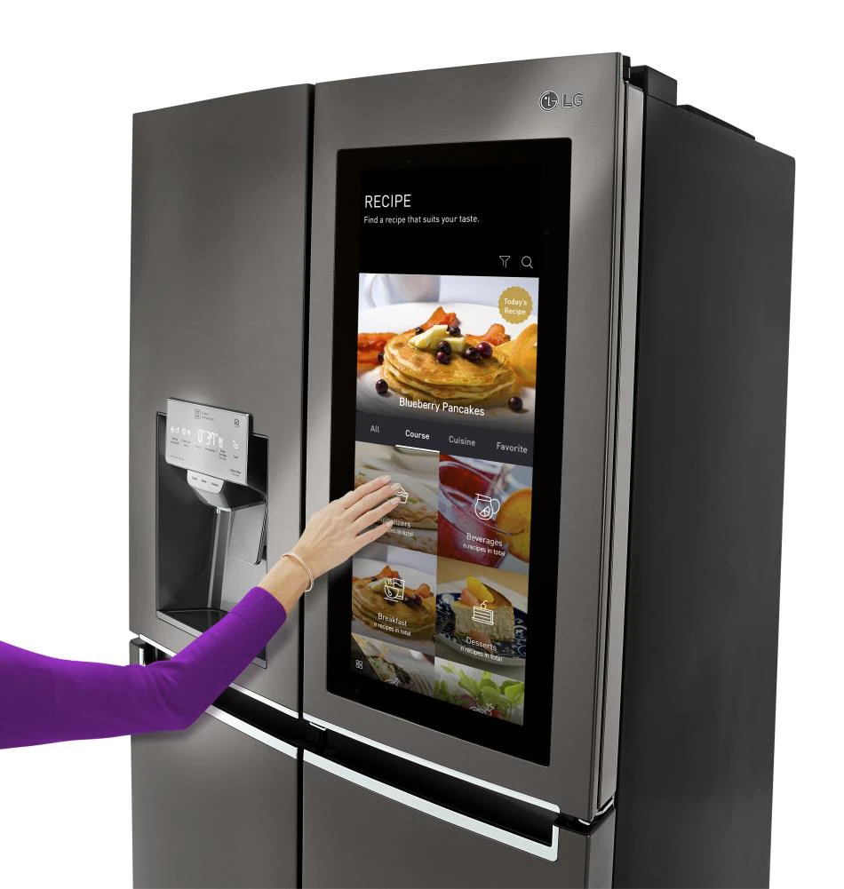
Notes:
User experiences are everywhere - website, mobile apps, even digital kiosks and wayfinding
Even now they’re in our cars and on our refrigerators.
Users expect a seamless experience and get frustrated when something that was designed to “help” them just causes frustration.

Slide 4
Setting context
What do I mean by user experience?
What is it like to use a website, mobile app, or other digital product?
Is it easy? Intuitive? A smooth experience end-to-end?
Or is it confusing? Buggy? More frustrating than it’s worth?
As a tech company … how do you know?
Notes:
If you’re very familiar with your product, and you know exactly how it should work, the experience might be seamless to you.
But to someone using your website or mobile app for the first time, what’s their experience? Is it good or bad? How do you know?

Slide 5
Typical ways to measure a user experience

Slide 6
Measuring the user experience: User Funnel (AARRR)
Acquisition: Are new users coming to your product (website, app, etc)?
Activation: Are new users converting?
Retention: Are users coming back?
Referral: Are users helping to attract more users?
Revenue: Are users upgrading or spending more money?
Notes:
Example: Amazon
Most product, marketing, and growth metrics support to one of these categories, which are important but if they change - what’s causing it? Maybe external factors, but what if it’s due to the experience?

Slide 7
Why measure effort?

Slide 8
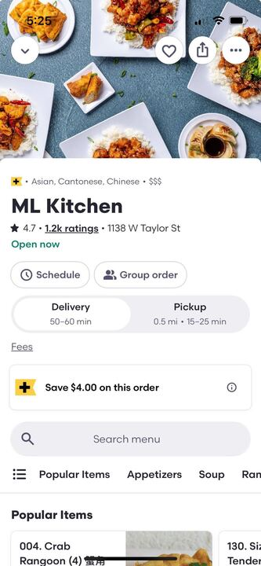
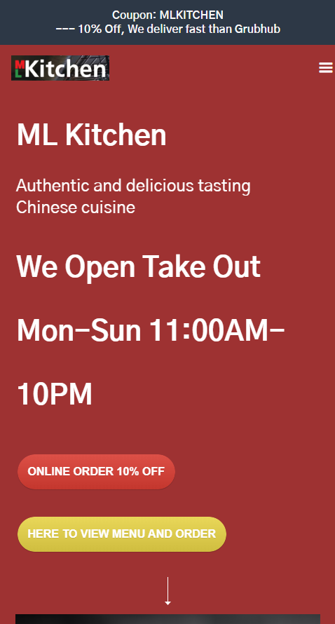

Why do we care about effort?
For tech companies, the user experience on your product can make or break your business.
Lost revenue:
Friction can drive customers to your competition or other options.
Higher costs:
A bad online experience can result in more calls or contact.
Notes:
Apps have become ubiquitous with food delivery even though ordering directly from the restaurant is often cheaper. Why do we favor a more expensive experience?
Additionally, if the online experience - which was meant to be convenient - has friction, the result might be calling you to place your order, which takes employee time which costs the business money.
Focusing on the negative outcomes of effort and friction can help you get more buy in - if you can show how it impacts the bottom line

Slide 9
Why do we care about effort?
Effort can also be a leading indicator of:
Abandonment
Contact
Low feedback
Lower return rate
Fewer new users
Client or customer churn

Slide 10
How to measure effort?

Slide 11
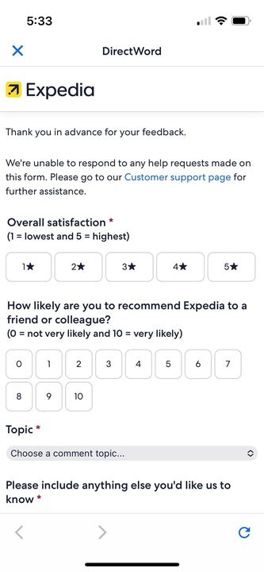
Collect User Feedback
Pros:
No guessing:
Tell you what they think
Insightful:
Can uncover problems you weren’t aware of
Cons:
Sparse:
Most customers won’t take the time
Polarized or skewed:
When they do, it’s only because their experience was very good or very bad
Inconsistent:
Based on opinion
Rating is impacted by other parts of experience
Gaps where data isn’t collected
Costly:
Need to implement a system to prompt and collect data
Notes:
Based on opinion - one user might think a good experience deserves a 5-star rating and another user might think it’s a 3-star rating
Other parts - Expedia probably only cares about the online booking experience but customers might use this form to complain about their actual travel experience
Gap - we were only collecting data after a user completed their booking and weren’t getting feedback when a user didn’t complete their booking

Slide 12
What else can be a signal of effort?
Notes:
While feedback data is important, there are other ways to use behavioral data to understand effort. And the upside is you can collect this for 100% of your users and it’s less subjective.

Slide 13
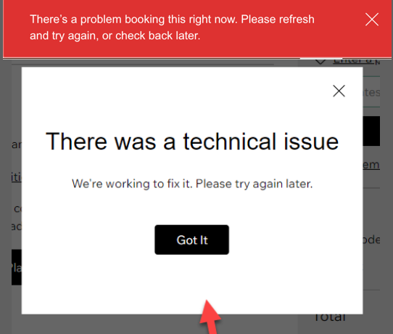
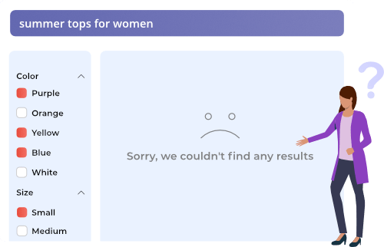
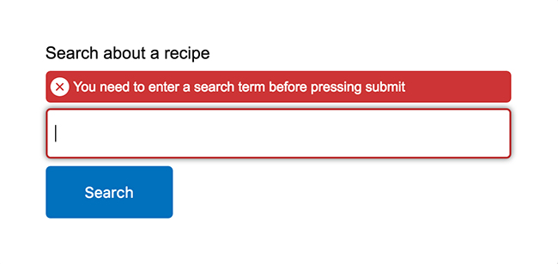
Blockers
Errors
Technical
User
No inventory

Slide 14
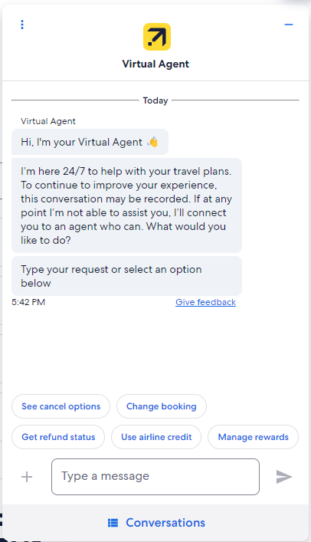


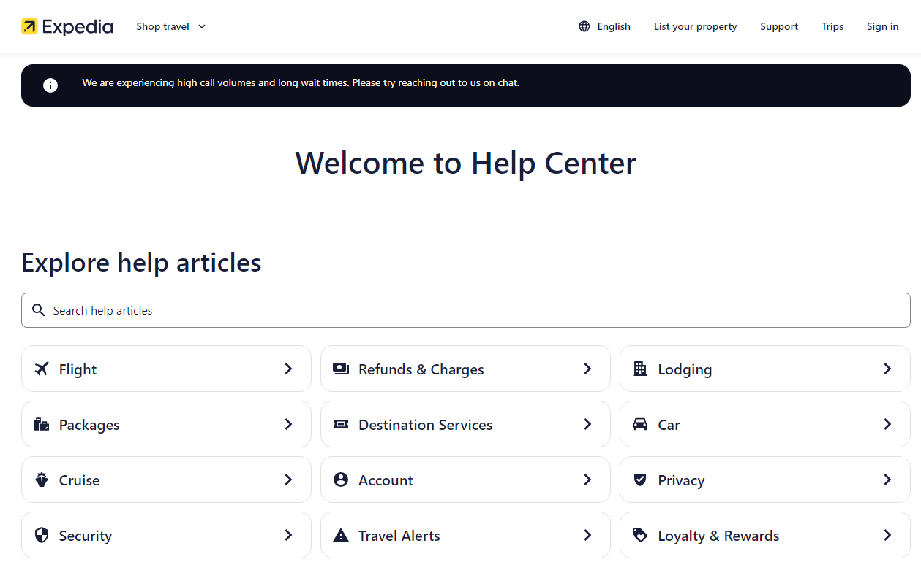
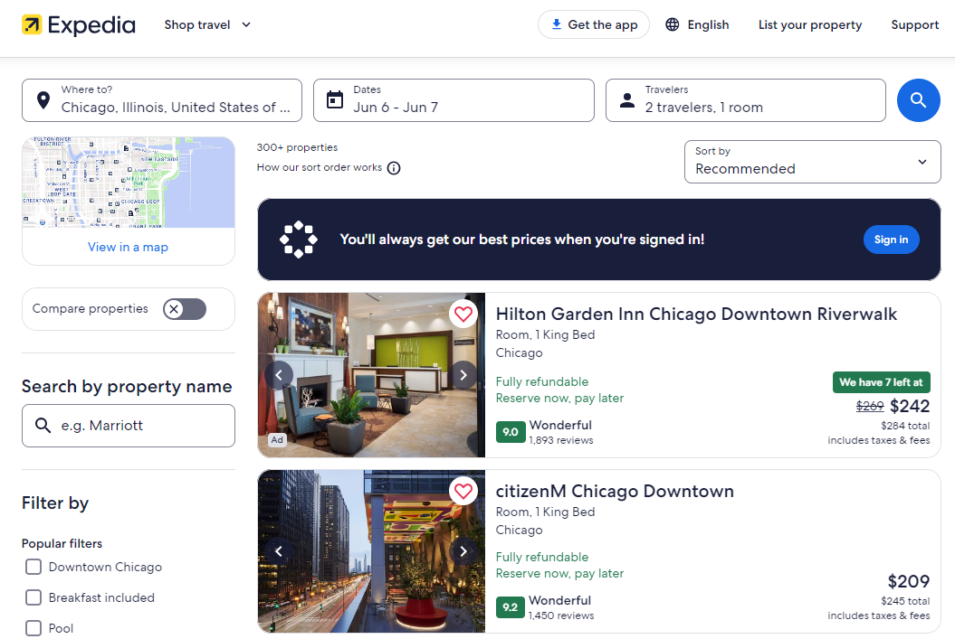
Possibly blocked
Repeating a task
Changing criteria
Visiting Help
Using Chatbot
Contacting us
Longer time on task

Slide 15
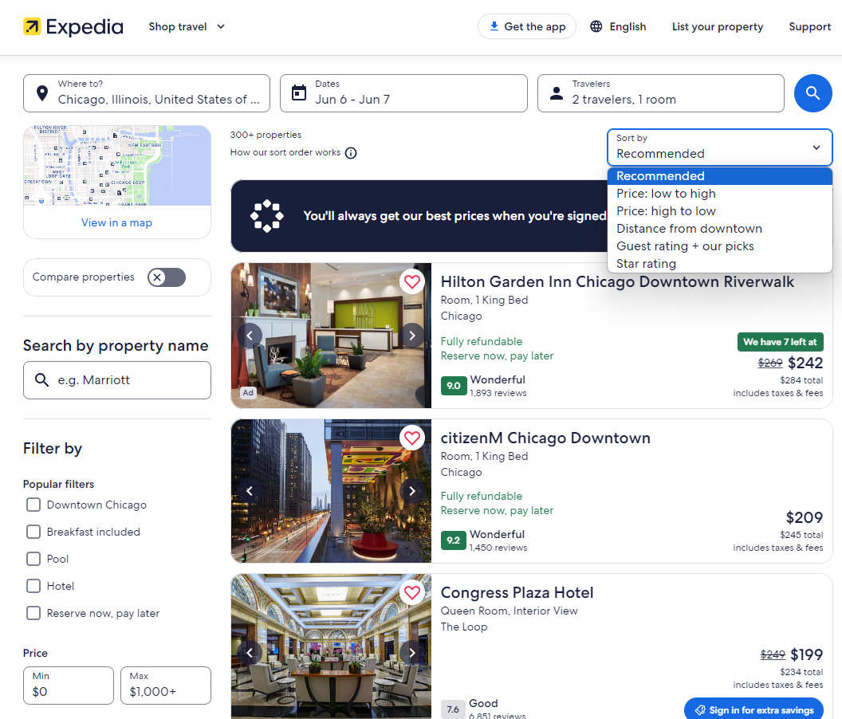
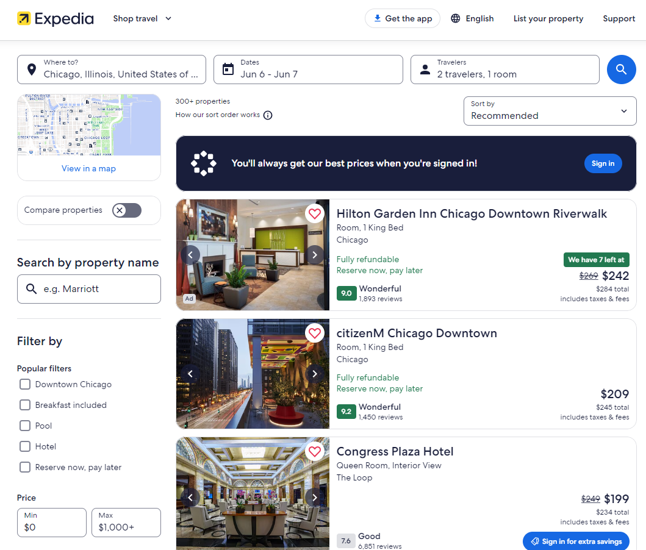
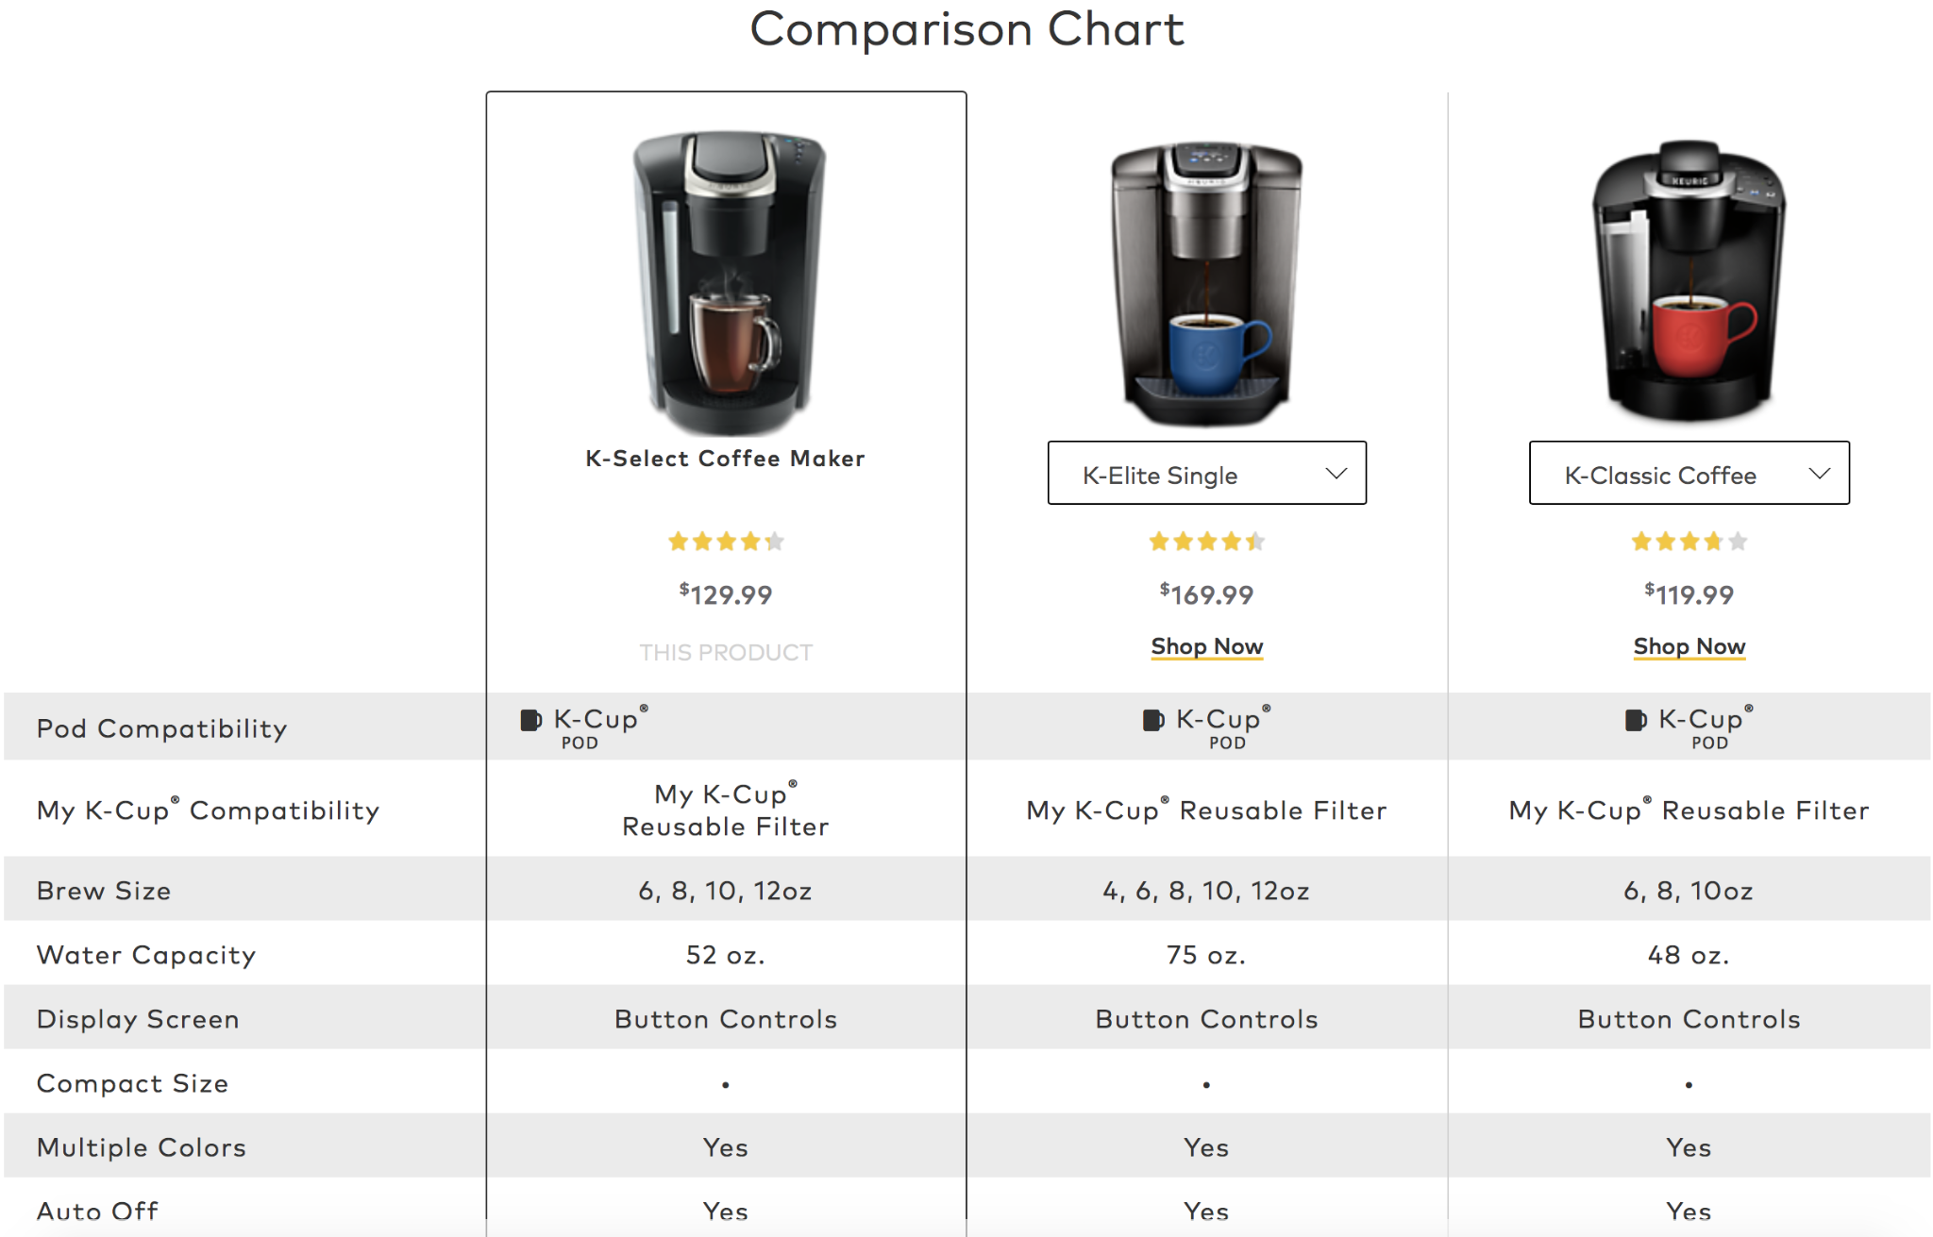
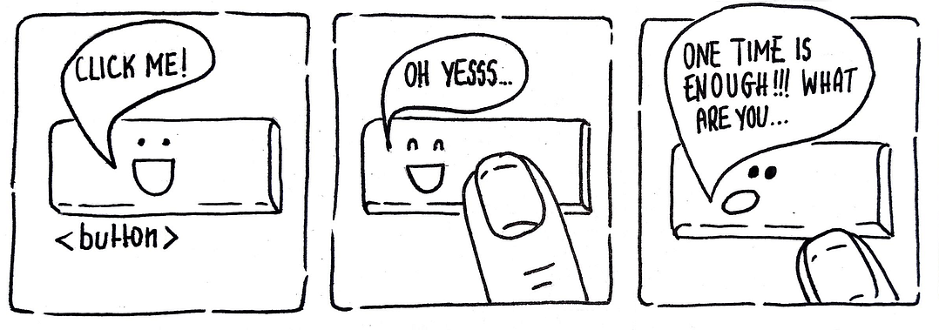
Extra steps
Filtering results
Changing sort order
Viewing multiple items
Going back and forth
Repeated clicks

Slide 16
Not all friction feels the same
Use correlations or predictive models to understand the relationship between friction and user behavior that impacts your bottom line:
Abandonment
Low or negative feedback
Contact (chat, calls, email)
Return rate
Referral rate

Slide 17
Human Learning + Machine Learning
Use the results of correlations and predictive models (feature importance) to measure the relationship between friction and business outcomes.
Apply your business or product knowledge as an extra layer of learning.
Create a calculated score applying different weights for friction experienced.
We call it a User Effort Index.
Notes:
Example: User Errors on Checkout had a high positive correlation /feature importance in relation to conversion (or completing an order). That doesn’t mean we want to increase user errors! It means that the problems was fixable and/or the user was already invested and wanted to see the task through to the end. Not all friction leads to a negative outcome but that doesn’t mean it’s part of a good user experience.

Slide 18
How can you impact the business?

Slide 19
Can you improve the User Experience?
Gaps in data collection
Can we fix our blind spots?
Identify pain points
High friction spots
Products or journeys that have more effort
Compare A/B test experiences
Which experiences have less effort
Understand user types
Who struggles more often

Slide 20
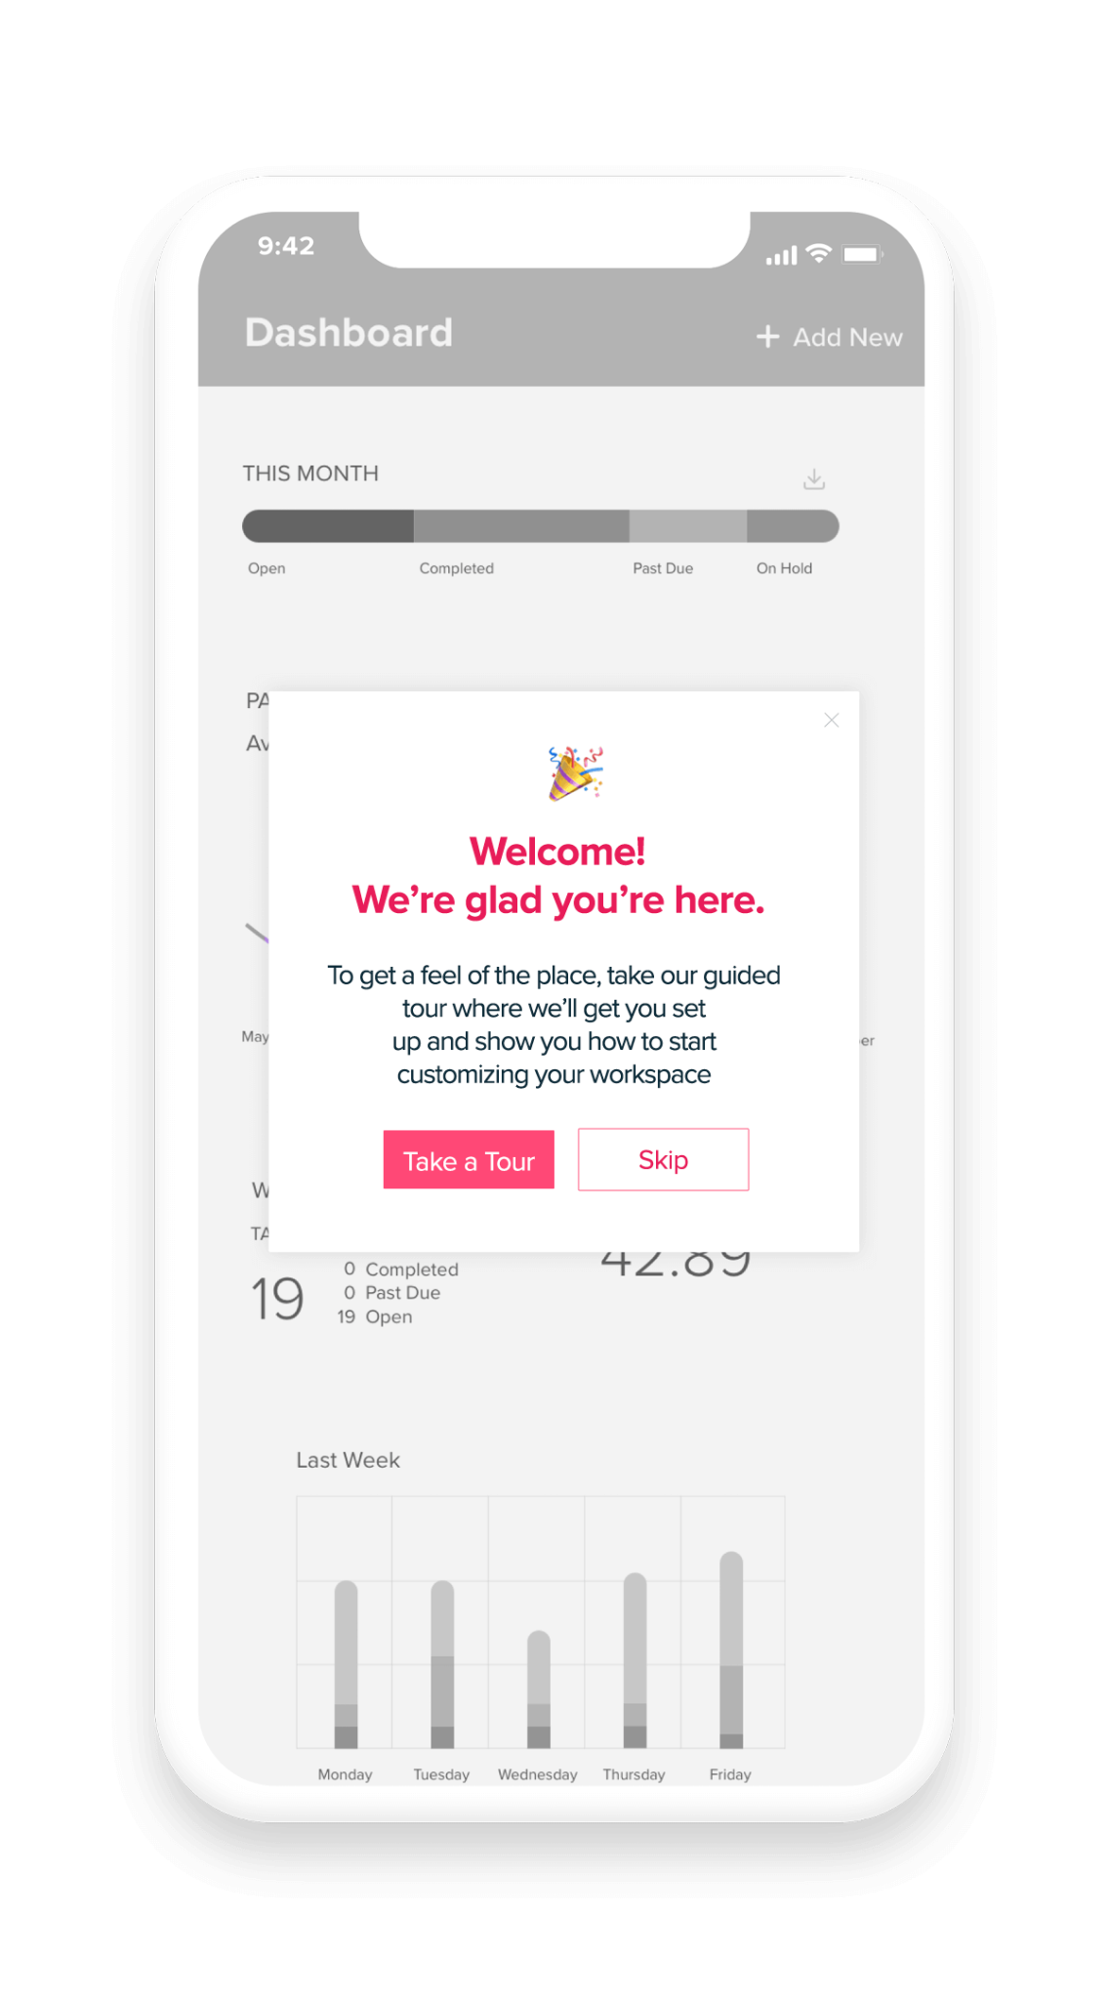
Can you avoid effort?
Identify Pain Points
Add messages or prompts

Slide 21
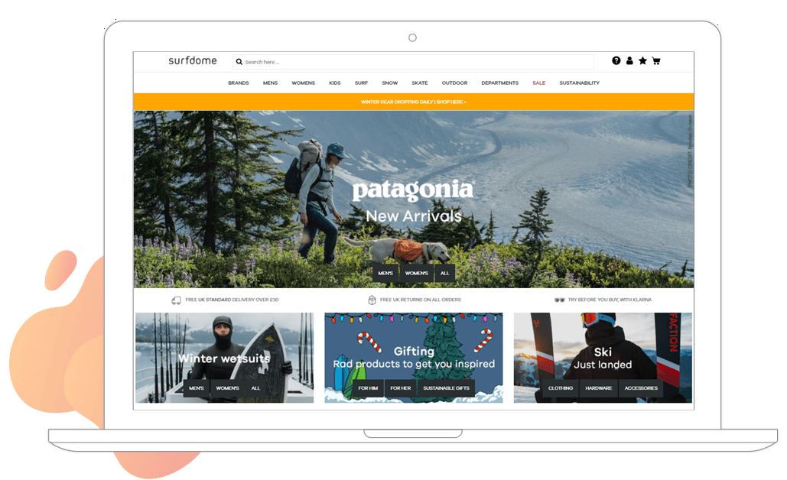
Can you avoid effort?
Identify Users Who Struggle More
Create a personalized journey

Slide 22
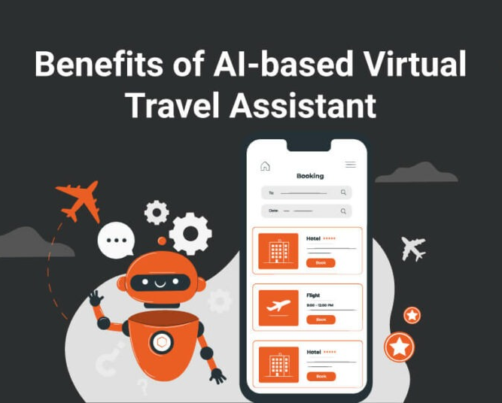
Can you avoid effort?
Identify Journeys with High Effort
Simplify the journey, maybe using AI

Slide 23
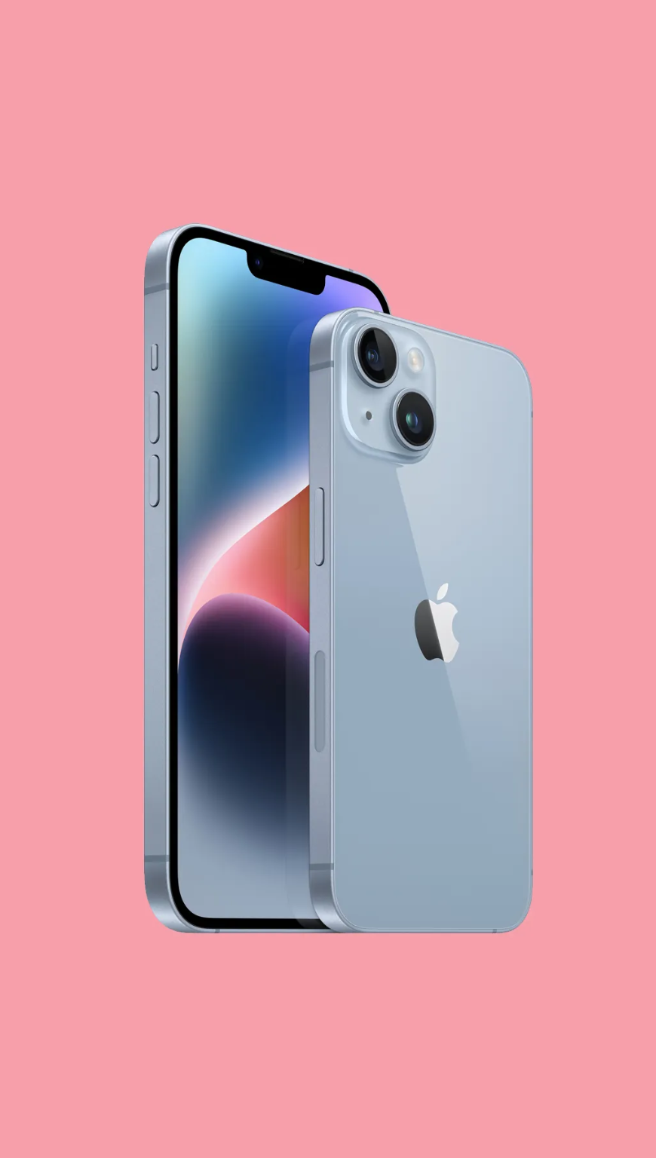
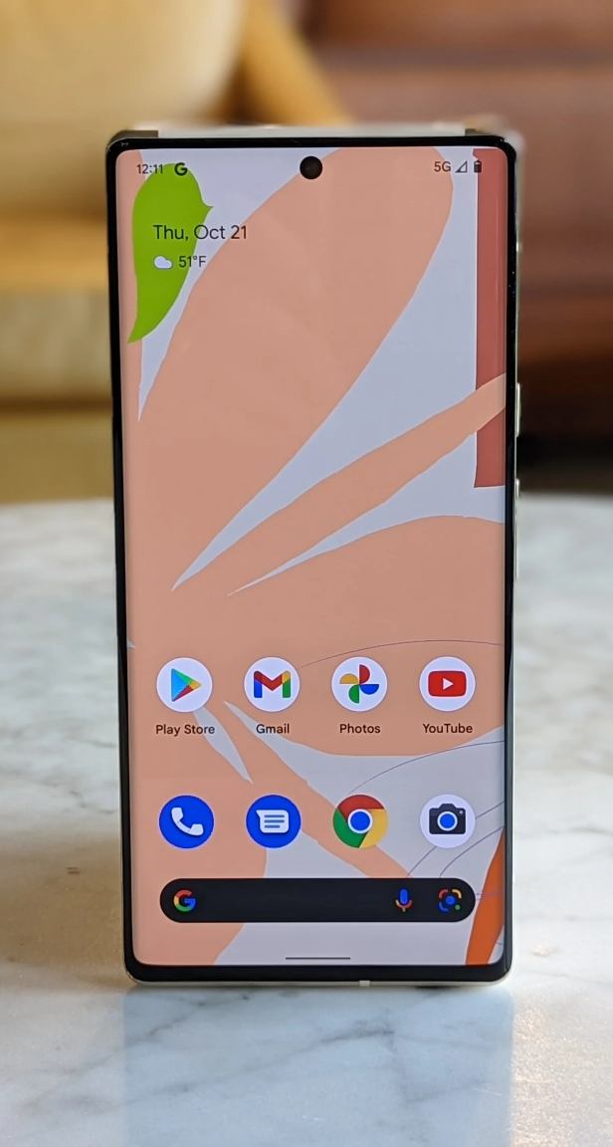
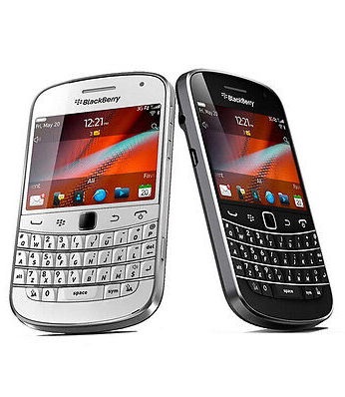
In closing, why should you care?
Notes:
In 2010, Blackberry had 40% of the US market
In 2011, iPhone launched on Verizon
By 2012, Blackberry was down to 6% of market share

Slide 24
Thank you

